Slide 1
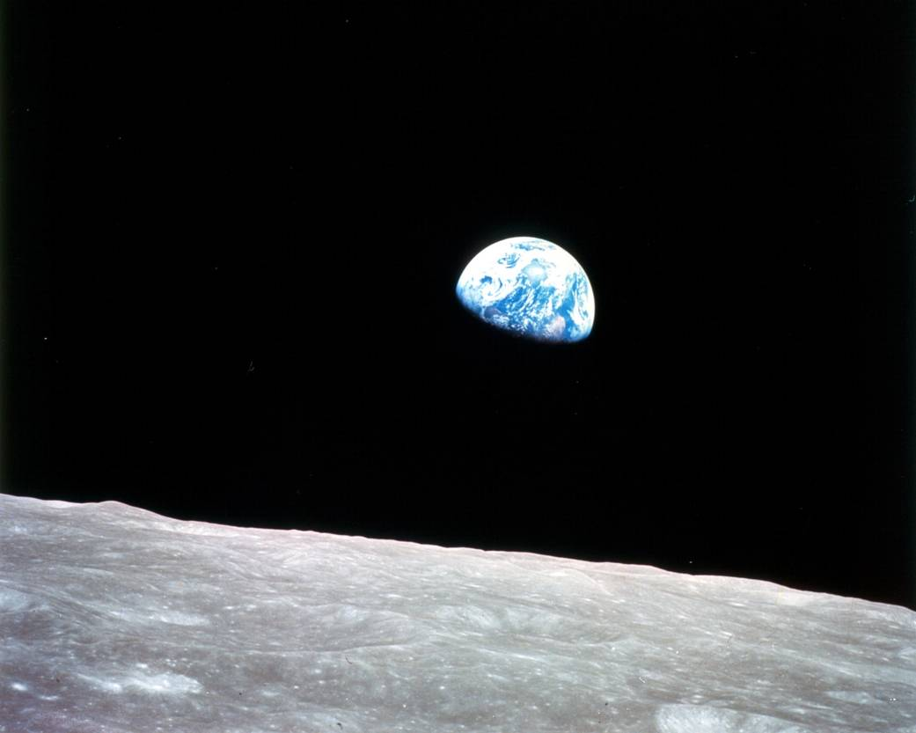
LAWYERING AS IF TOMORROW MATTERS
John C. Dernbach
“Earthrise,” taken by William Anders,
Apollo 8, during lunar orbit, Dec. 24, 1968

Slide 2
1.3 million lawyers licensed to practice law in U.S.
Environmental law—47,707
Sustainable development or sustainability--759
Climate change--749
Renewable energy--826
Figures from 2017; Martindale-Hubble directory no longer has this information

Slide 3
But we are facing an emergency
(1) a serious, unexpected, and often dangerous situation
(2) requiring immediate action:
can’t keep doing what we have been doing
must do things that we have not been doing

Slide 4
The climate emergency in a nutshell
Greenhouse gases in the atmosphere are higher now than they have been in more than in three million years.
We are already experiencing the effects of climate change—all over the world.
We must achieve significant reductions by 2030—in this decade—to have a decent chance of getting to zero by 2050.
And there are other serious issues….

Slide 5
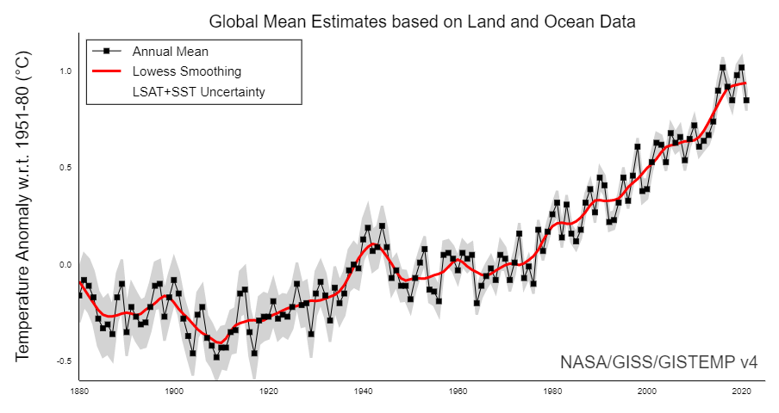

Slide 6
We need to push back against the “new normal”
Climate is changing in disruptive ways.
We can’t/won’t do enough to stop it.
So we go about our regular routines as if there is no problem.

Slide 7
Why do lawyers matter here?
Law is a necessary means of addressing climate change and accelerating the transition to sustainable development.
Rich history of lawyers advancing important causes
“All hands on deck” needed.
It’s about justice, stupid (borrowing from James Carville).

Slide 8
Great potential to make progress
1.3 million lawyers are licensed to practice law in U.S.
Plus 112,000 law students
What would happen if more lawyers (and law students) took leadership roles?
More specifically, what should lawyers do?

Slide 9
What lawyers can do
1. Work for better public and private governance
2. Embrace sustainability and climate change action more fully in law practice
3. Figure out where you fit in, and go for it
4. Walk the talk on reduced greenhouse gas emissions
5. Work for law reform
6. Join/partner/participate in/lead similarly minded organizations
7. Spread the word

Slide 10
1. Work for better public and private governance
Make America safe for democracy
Civic engagement
Civil discourse

Slide 11
2. Embrace sustainability and climate change action more fully in law practice
Iconic definition of sustainable development: “development that meets the needs of the present without compromising the ability of future generations to meet their own needs.”
World Commission on Environment and Development, Our Common Future (1987)

Slide 12
Conventional Development
PROGRESS:
--Peace & security
--Economic Development
--Social Development/ Healthy Communities
PRICE OF PROGRESS:
--Environment & Natural Resources
--Living people who are harmed (health, property, etc.)
--Future generations that are harmed

Slide 13
Traditional approach to development: regulation
Predominant orientation: development or environment
Assume continued existence of incumbent technologies, and tends to protect them
Use regulation to reduce their adverse effects
Contributes to polarized politics about environment

Slide 14
Sustainable Development
PROGRESS:
--Peace & security
--Economic development
--Social development/human rights
--Environmental protection/restoration
--Supportive national governance

Slide 15
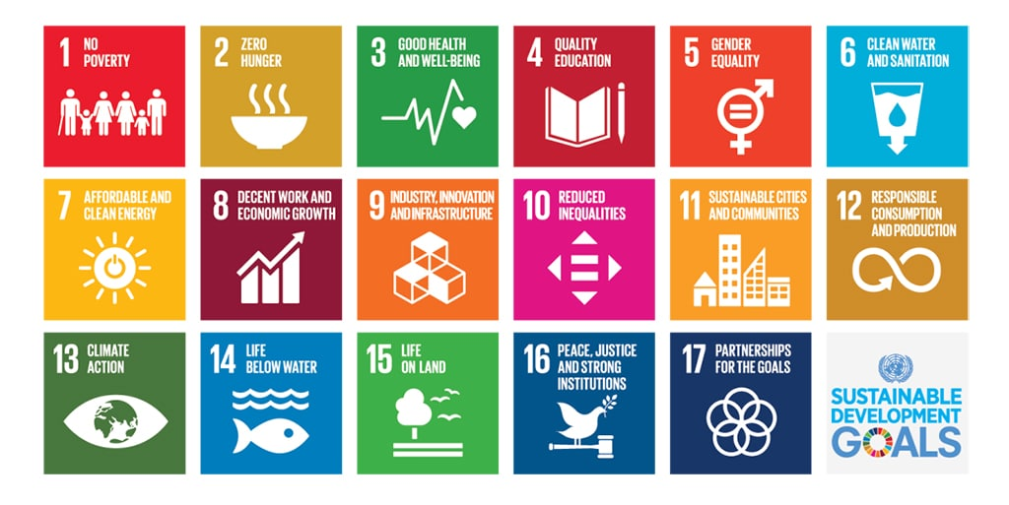
Sustainable Development Goals

Slide 16
Sustainable development
Is more equitable than conventional development
Produces a wider range of benefits
Has fewer costs
It is therefore the best approach to reducing greenhouse gas emissions and adapting to climate change.

Slide 17
Sustainable development opens up space for new laws and policies
Predominant approach: development and environment
It is about redirecting development
Open to “disruptive” technological and other change
Traditional regulation still necessary.
Creates opportunities for use of approaches that are different from traditional regulation.

Slide 18
What do Sustainability Lawyers Do?
Sustainability/climate change in law practice tends to focus on:
Reducing adverse environmental and social impacts; creating positive impacts.
Maximizing environmental, social, and economic opportunities for clients.
Sustainability can provide more and better choices to clients—if client is open to those choices.
Lawyers with skill, expertise, and knowledge to develop and communicate those choices are more likely to succeed.
Source: Sustainable Development in Law Practice: A Lens for Addressing All Legal Problems, https://papers.ssrn.com/sol3/papers.cfm?abstract_id=2836985

Slide 19
3. Figure out where you fit in, and go for it

Slide 20
Work Toward Sustainability Wherever You Are
There are few purely sustainable development lawyers.
Basic career advice:
Find an area of law and practice, and learn a set of skills, that suit you.
Then develop expertise on how sustainable development can add value for clients and stakeholders in that context.
In so doing, build sustainability into whatever legal job you have.

Slide 21
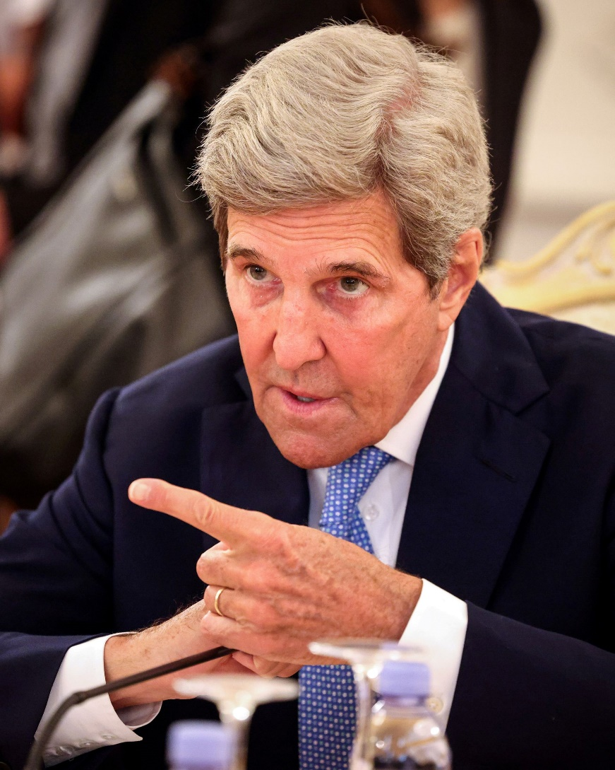
“You are all climate lawyers now”—John Kerry
Bankruptcy
Transactions
Financing
Construction contracting
Land use
Procurement
Drafting
Administration
Enforcement
Negotiation

Slide 22
Focus on facts and laws relevant to the client/decision maker
Opportunities and avoided risks
Economic (profits, cost savings, economic growth)
Environmental (greenhouse gas emissions, other pollutants, environmental protection)
Social (jobs, community wellbeing, social license, public health)

Slide 23
4. Walk the talk on reduced greenhouse gas emissions
At work:
Working with clients
Pro bono activities
Greening the law office
At home
In public and in the voting booth

Slide 24
5. Work for Law Reform

Slide 25
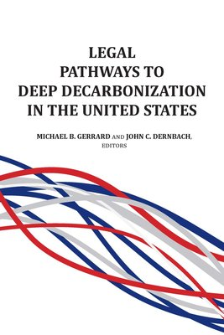
Legal Pathways to Deep Decarbonization in the United States
Question: What laws or combinations of law are needed to achieve these outcomes?
Prof. Michael Gerrard and I are editing a 35-chapter book that is intended to be a legal playbook for this effort.
Chapter recommendations are framed in terms of sustainable development
More than 1,500 legal pathways:
Federal
State and local
Private governance

Slide 26
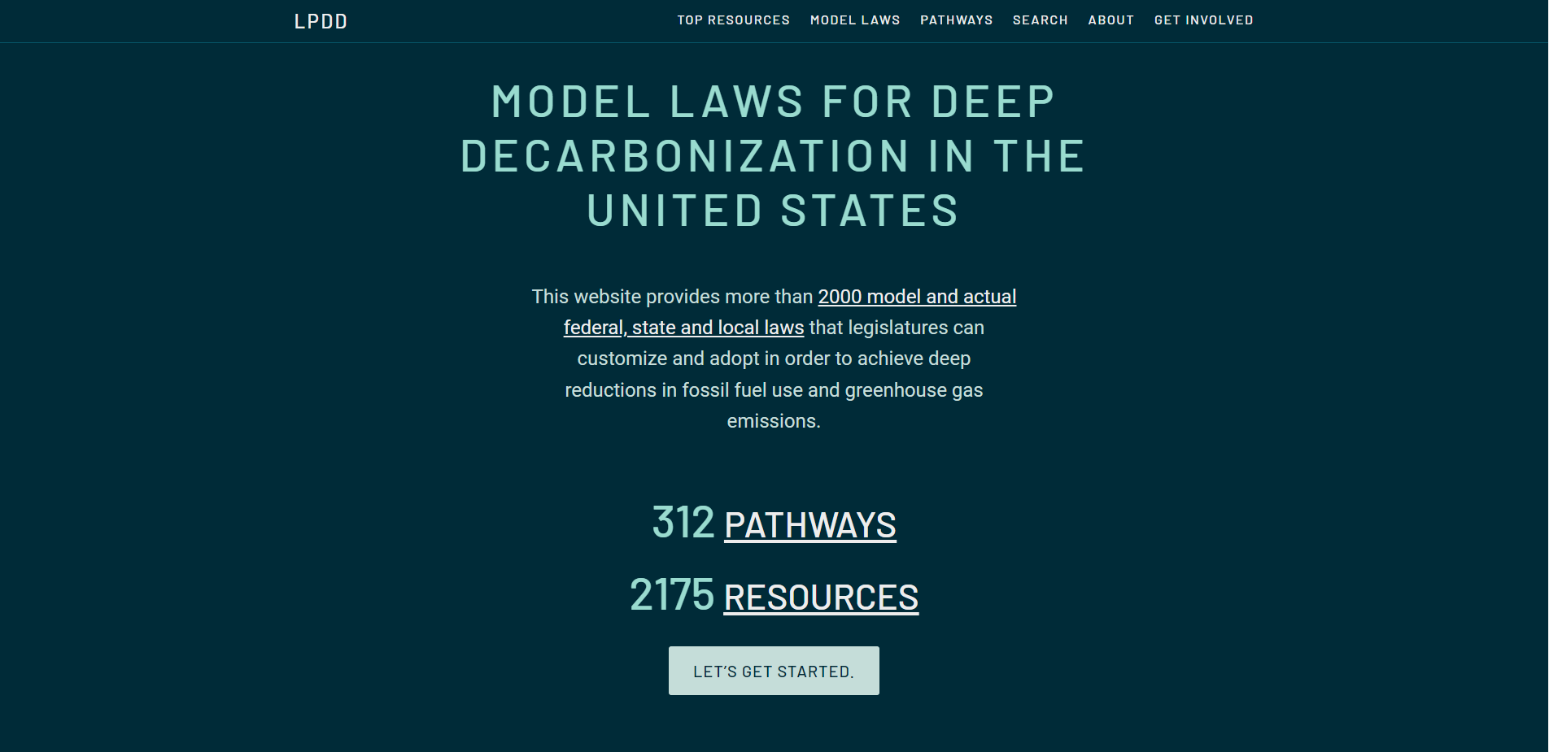

Slide 27
6. Join/partner/participate in/lead similarly minded organizations

Slide 28
2019 American Bar Association House of Delegates Resolution
Urges “lawyers to engage in pro bono activities to aid efforts to reduce greenhouse gas emissions and adapt to climate change.”
Urges lawyers “to advise their clients of the risks and opportunities that climate change provides.”

Slide 29
International Bar Association 2020 Statement on Climate Crisis
Urges lawyers “to consider . . . taking a climate conscious approach to problems encountered in daily legal practice.”
This includes:
Advising clients
Pro bono activity.
Encourages “lawyers to engage with current and future legislative and policymaking efforts to address the climate crisis.”

Slide 30
Lawyer organizations to address climate change
Deep Decarbonization Model Law Drafting Project
Renewable Energy Legal Defense Initiative
Climate Science Legal Defense Fund
Chancery Lane Project
ESELA Network
Net Zero Lawyers Alliance

Slide 31
Law Firm Sustainability Organizations
Law Firm Sustainability Network
Legal Sustainability Alliance

Slide 32
7. Spread the word
This is an emergency.
Talk about it.
We are running out of time.
Share hope and tools that can work.
Persuade, inspire, and encourage others.

Slide 33
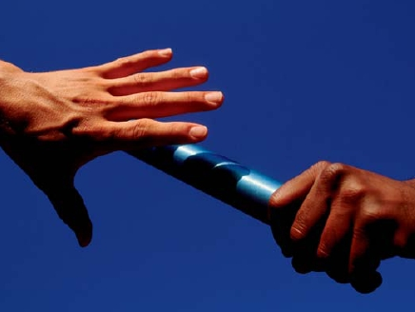
When appropriate, make the case in moral, ethical, and even religious terms
Once we start to think about the kind of world we are leaving to future generations, we look at things differently; we realize that the world is a gift which we have freely received and must share with others. Since the world has been given to us, we can no longer view reality in a purely utilitarian way, in which efficiency and productivity are entirely geared to our individual benefit.
--Pope Francis I,
Laudato Si

Slide 34
Moral/Ethical principles include:
Intergenerational equity
Do no harm
Prudent stewardship
Individual accountability for consequences of one’s actions

Slide 35
Prof. John C. Dernbach
Widener University
Commonwealth Law School
3800 Vartan Way
Harrisburg, PA 17106-9382
(717) 541-1933
(717) 541-3966 (fax)
jcdernbach@widener.edu
http://ssrn.com/author=411559
http://www.johndernbach.com/

